Slide 1




Local Sensitivity to Nonignorable Missingness in Overdispersed Count Using Negative Binomial Model
Bocheng Jing, Grisell Diaz-Ramirez, Qian Yi, Joan X Hu, Elizabeth L Whitlock ,W. John Boscardin, Hui Xie

Slide 2
ADL after Major Cardiac Surgery
Inspired by Dr. Whitlock et al (2021)’s work: comparing ADL deficiency after Cardiac Surgeries.
Data Source: Health and Retirement Study (HRS), a nationally representative survey.
ADL (Activities of Daily Living): Measures elderly functionality and health post-hospitalization. Scores range from 0 to 6, assessing (Count outcome):
Bathing, Dressing, Eating, Toileting, Walking across a room, Getting in and out of bed
Key intervention -- major cardiac surgeries:
CABG (Coronary Artery Bypass Graft) vs. PCI (Percutaneous Coronary Intervention)
Hypothesis: CABG may lead to greater ADL impairment than PCI due to its invasiveness.
Covariates Adjusted: Procedure type, age, sex, self-reported comorbidities (diabetes, hypertension, falls, heart failure, pain, stroke), and marital status.

Slide 3


Missing Data in the ADL Count
1,015 and 665 patients underwent PCI and CABG: average age of 75 (SD, 7), 58.9% male, 87.0% white. Baseline ADL score similar (P=0.45)
Modeling: initially Poisson regression
Overdispersion in ADL
Test for dispersion with p-value<0.001, suggesting overdispersion.
Switched model from Poisson to Negative Binomial Regression
Estimated dispersion parameter $α=0.127$, indicating large dispersion.
Model was run under the MAR assumption-- procedure type is not a significant factor affecting ADLs (CABG is the reference)
However, a moderate amount (14.8%) of postoperative ADLs were not reported, raising concerns to the validity of the procedure estimate ($β_{1}$=-0.306).
Potentially, the more invasive CABG could lead to greater impairments in ADL, resulting in patients being unable to respond to ADL questions.
Parameter | MAR Estimate | Standard Error | P-value
Intercept ($β_{0}$) | -4.235 | 1.128 | 0.000
procedure ($β_{1}$) | -0.306 | 0.194 | 0.114
age ($β_{2}$) | 0.032 | 0.015 | 0.031
male ($β_{3}$) | -0.261 | 0.212 | 0.218
diabetes ($β_{4}$) | 0.720 | 0.200 | 0.000
falls ($β_{5}$) | 0.301 | 0.201 | 0.134
hypertension ($β_{6}$) | 0.175 | 0.208 | 0.400
heart failure ($β_{7}$) | 0.842 | 0.369 | 0.022
pain ($β_{8}$) | 0.491 | 0.205 | 0.016
stroke ($β_{9}$) | 1.067 | 0.251 | 0.000
marriage ($β_{10}$) | 0.059 | 0.220 | 0.787
$$α$$ | 0.127 | 0.015 | -0.004

Slide 4
Sensitivity Analysis for the Missing ADL Count
Importance of Missing Data Mechanisms (MDM)
Describes how missingness occurs and affects analysis and results.
Missing at Random (MAR)
MAR: Missing values, if known, provide no additional predictive value given observed data.
Ignorability: MAR + Parameters of the complete data model are distinct from the MDM's parameters.
Advantage: Simplifies the analysis process, ensuring valid inferences with likelihood-based/Bayesian analysis.
Common Issues with MAR Assumptions
Oversimplification: Unverified MAR assumptions can lead to biased results.
Impact: Undermines the reliability of conclusions drawn from the data.
Sensitivity Analysis
Purpose: Evaluates how estimates change under alternative MDMs.
Local Sensitivity Analysis: Examines the effect of slight departures from the MAR assumption.
Preferably, the MDM is "ignorable" for valid inferences without direct estimation.

Slide 5
Index of Local Sensitivity to Nonignorability (ISNI)
Assesses the impact of deviating from the MAR assumption on regression estimates.
Specify Models:
Complete Data Model: Define the model for the complete data.
Missing Data Mechanism (MDM): Define where missingness depends on the outcome, indexed by a nonignorability parameter.
Analysis Process:
Evaluate how the parameter estimate of the outcome model changes with varying nonignorability parameter values.
Robustness Check:
Small Changes: Results are robust.
Significant Changes: Indicates higher sensitivity to nonignorable missingness.
Advantages
Avoids the complexity of estimating nonignorable models.
Computationally efficient for large datasets and various study designs.
ISNI development
Troxel et al (2004) for GLM (including Poisson); Hui et al extended ISNI to GLMM (2008, 2012)

Slide 6

ISNI for Negative Binomial Regression Setup
Complete Data Model for Negative Binomial (NB) Regression
$P\left(Y=y\right)=\frac{Γ\left(y+α\right)}{y!Γ\left(α\right)} {\left(\frac{α}{α+μ}\right)}^{α}{\left(\frac{μ}{α+μ}\right)}^{y}$
$μ=\exp{{(X}^{′}β)}$; $α$ = dispersion parameter
The mean and variance of Y are expressed as $μ$ and $μ+\frac{1}{α}μ^{2}$
Missing Data Selection Model
$P\left(G_{i}=1 | Y_{i}=y_{i}, S_{i}=s_{i}\right)=h(γ_{0}s_{i}+γ_{1}y_{i})$.
$G_{i}=1$if $y_{i}$ is missing, 0 if observed.
$γ_{0}$ and $γ_{1}$​ are coefficients indicating the influence of observed data and potential unobserved outcomes on missingness.
Joint log-likelihood function
$\ln{L}=\sum_{i=1}^{n}{\{(1−g_{i})[\ln{f_{α,β}\left(y_{i}^{obs} | x_{i}\right)}}+ln⁡(1−h(γ_{0}s_{i}+γ_{1}y_{i}^{obs}))]+g_{i}ln\int_{Ω_{y^{mis}}}{f_{α,β}\left(y_{i}^{mis} | x_{i}\right)h\left(γ_{0}s_{i}+γ_{1}y_{i}^{mis}\right)dy_{mis}}$
$y^{obs}$ and $y^{mis}$ denote the observed and missing parts of count outcomes,
$Ω_{y^{mis}}$ is the sample space for $Y^{mis}$

Slide 7
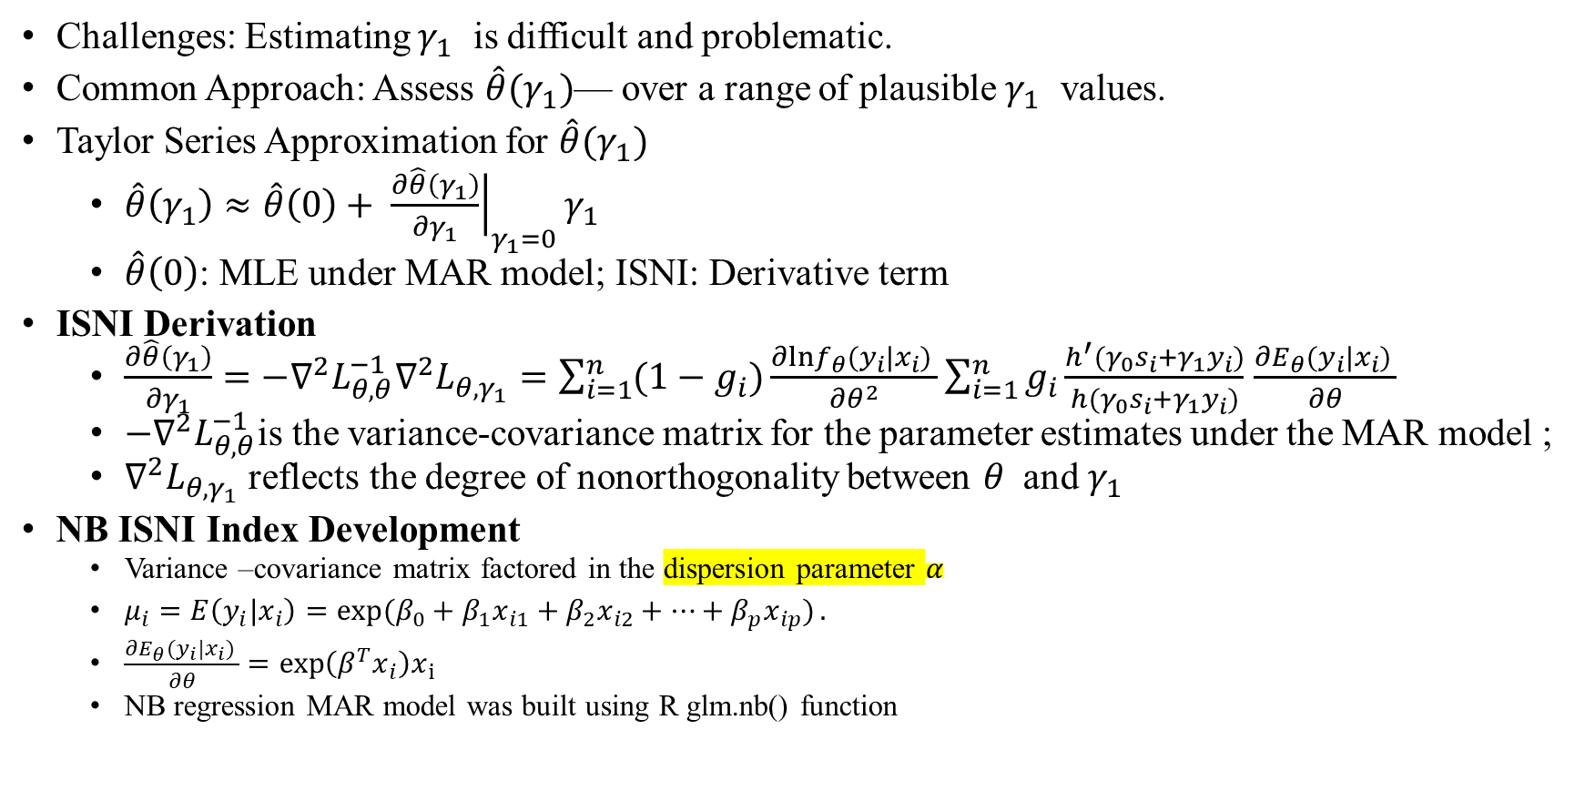
NB ISNI Derivation
Challenges: Estimating $γ_{1}$ ​ is difficult and problematic.
Common Approach: Assess $\hat{θ}(γ_{1})$— over a range of plausible $γ_{1}$ ​ values.
Taylor Series Approximation for $\hat{θ}(γ_{1})$
$\hat{θ}\left(γ_{1}\right)≈\hat{θ}\left(0\right)+ {\left.\frac{∂\hat{θ}\left(γ_{1}\right)}{∂γ_{1}}\right|}_{γ_{1}=0}γ_{1}$
$\hat{θ}\left(0\right)$: MLE under MAR model; ISNI: Derivative term
ISNI Derivation
$\frac{∂\hat{θ}\left(γ_{1}\right)}{∂γ_{1}}=−∇^{2}L_{θ,θ}^{−1}∇^{2}L_{θ,γ_{1}}=\sum_{i=1}^{n}{(1−g_{i})\frac{∂lnf_{θ}(y_{i}|x_{i}) }{∂θ^{2}}\sum_{i=1}^{n}{g_{i}\frac{h^{′}(γ_{0}s_{i}+γ_{1}y_{i})}{h(γ_{0}s_{i}+γ_{1}y_{i})}}}$ $\frac{∂E_{θ}(y_{i}|x_{i}) }{∂θ}$
$−∇^{2}L_{θ,θ}^{−1}$is the variance-covariance matrix for the parameter estimates under the MAR model ;
$∇^{2}L_{θ,γ_{1}}$ reflects the degree of nonorthogonality between $θ$ and $γ_{1}$
NB ISNI Index Development
Variance –covariance matrix factored in the dispersion parameter $α$
$μ_{i}=E\left(y_{i}|x_{i}\right)=\exp{(β_{0}+β_{1}x_{i1}+β_{2}x_{i2}+…+β_{p}x_{ip})}.$
$\frac{∂E_{θ}(y_{i}|x_{i}) }{∂θ}=exp\left(β^{T}x_{i}\right)x_{i}$
NB regression MAR model was built using R glm.nb() function

Slide 8

ISNI Interpretation
ISNI represents change of rate $\hat{θ}(γ_{1})$ at $γ_{1}=0$
$\hat{θ}\left(γ_{1}\right)≈\hat{θ}\left(0\right)±$ ISNI ($\hat{θ}$)$×γ_{1}$
E.g. Reflects shift in MLE from MAR estimate when $γ_{1}$​ shifts from 0 to 1: $\hat{θ}\left(γ_{1}\right)≈\hat{θ}\left(0\right)+$ISNI (1)
Logistic Selection Model
$P\left(G_{i}=1 | Y_{i}=y_{i}, S_{i}=s_{i}\right)=h\left(γ_{0}s_{i}+γ_{1}y_{i}\right)=\frac{exp⁡(γ_{0}s_{i}+γ_{1}y_{i})}{1+exp⁡(γ_{0}s_{i}+γ_{1}y_{i})}$
One-unit increase in outcome -> 2.7-fold increase in odds of being missing.
Continuous Outcomes (e.g. HbA1C, Systolic Blood Pressure):
ISNI interpretation influenced by measurement unit.
Consider moderate nonignorability effect: $\hat{θ}\left(1\right)≈\hat{θ}\left(0\right)±$ ISNI$×\frac{1}{σ_{Y}}$ ---------- (1)
Minimal Degree of Nonignorability (MinNI)
Consider that the parameter shifts by one standard error to be significant, e.g $\hat{θ}\left(1\right)≈\hat{θ}\left(0\right)±{SE}_{θ}$--------(2)
MinNi is a scaling factor wherein a change of $\frac{1}{MinNi}$ SD of Y corresponding with an odds ratio of 2.7 in the probability of being missing
$ISNI×\frac{1}{\frac{1}{MinNI}SD}/SE_{θ}$=1 →MinNI=$|\frac{ISNI×σ_{Y}}{SE_{θ}}|$
Interpretation
Small MinNI→ sensitive to modest nonignorability; large MinNI→ sensitive only to extreme nonignorability.
MinNI = 10: a 0.1-SD unit change in Y leading to a 2.7-fold change in the odds for missingness– this is unlikely hence deemed as insensitive to nonignorability.
MinNI = 0.1: a 10-SD unit change in Y leading to a 2.7-fold change in the odds for missingness– this is likely and we regard this degree of nonignorability as likely to occur.

Slide 9

Simulation Studies on ISNI and Nonignorability
Purpose:
Study 1: Evaluate the performance (bias=ISNI-adjusted estimate – true parameter) of the new NB ISNI vs. existing Poisson ISNI in overdispersed count outcomes.
Study 2: Investigate the impact of dispersion degree $α$ on ISNI values.
Study 3: Examine the impact of the proportion of missing data on ISNI values.
Setting:
1,000 datasets per scenario; 500 per dataset; Covariate 𝑋: Normally distributed (mean 0, SD 1);
mean count 𝜇=exp(1+0.5𝑋) generated from the NB model;
true parameters: Intercept = 1, Coefficient of 𝑋 = 0.5
To simulate nonignorable missingness in the outcome, $P\left(G_{i}=1 | x_{i}, y_{i}\right)=\frac{exp⁡(−6+2X_{i}+1y_{i})}{1+exp⁡(−6+2X_{i}+1y_{i})}$
Study 1: Plotting various levels of $α$ to assess the bias.
Study 2: ISNI and MinNI values plotted against $α$, ranging from 0 to 25
Study 3: Varying missing proportion from 0.1 to 0.8 in increments of 0.1, and examine the ISNI and MinNI values.

Slide 10
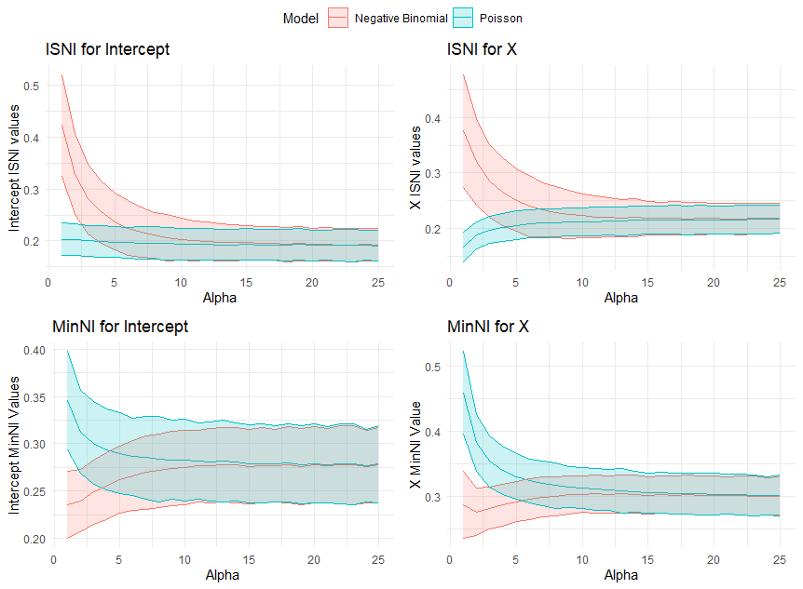
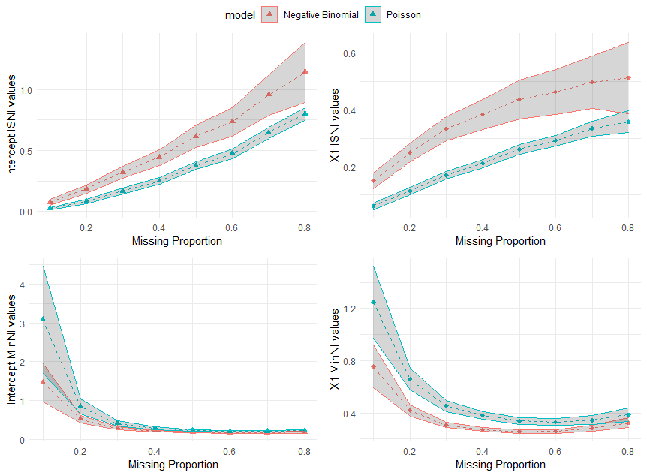
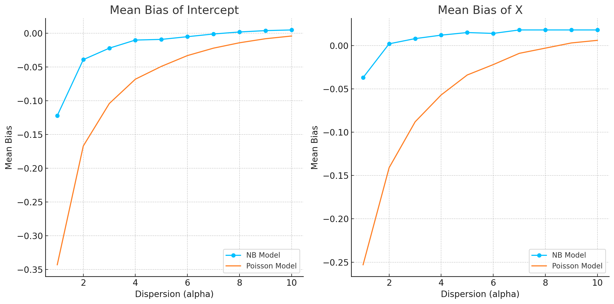
Simulation Results

Slide 11

Simulation Results Summary
Simulation Study 1:
At higher dispersion levels, the NB ISNI adjusted estimates demonstrated significantly smaller mean biases for both the intercept and coefficient of X compared to the Poisson ISNI model.
Simulation Study 2:
Higher dispersion (smaller $α$ values) led to increased ISNI values and decreased MinNI values, indicating higher sensitivity to nonignorability.
The Poisson model's ISNI value remained relatively unaffected by varying levels of dispersion, highlighting its limitation in handling different dispersion scenarios.
Simulation Study 3:
Higher proportions of missing data resulted in increased ISNI values and decreased MinNI values for both the intercept and coefficient of X.
The relationship between ISNI values and missing data proportion was consistent, with greater missing proportions linked to increased sensitivity to nonignorability.
The Poisson model showed comparatively lower ISNI values than the NB model, attributed to the dispersion factor discussed in Study 2.

Slide 12
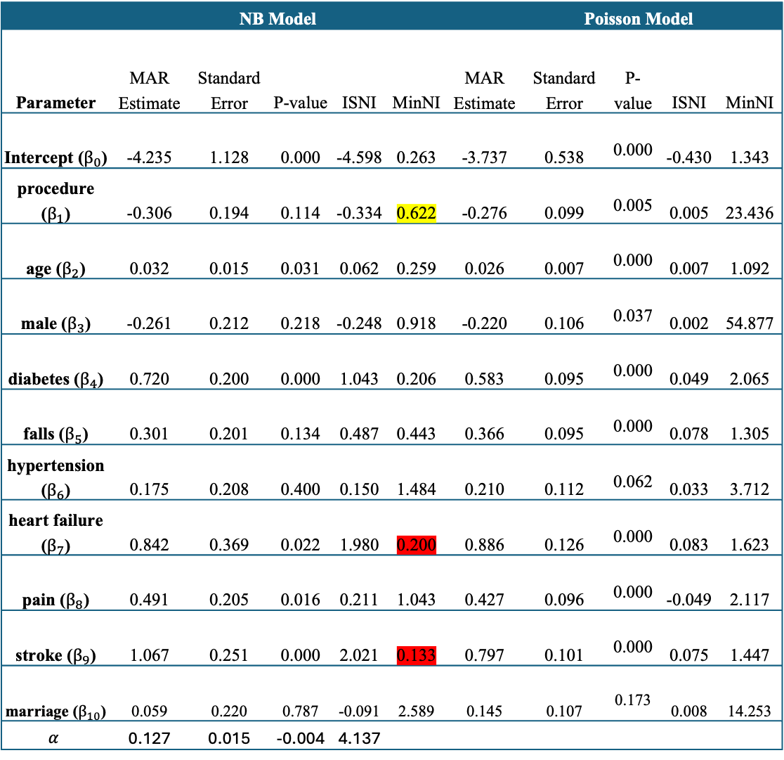

ISNI Model for the ADL Count Outcome
 | NB Model |  |  |  |  |  | Poisson Model
Parameter | MAR Estimate | Standard Error | P-value | ISNI | MinNI | MAR Estimate |  | Standard Error | P-value | ISNI | MinNI
Intercept ($β_{0}$) | -4.235 | 1.128 | 0.000 | -4.598 | 0.263 | -3.737 |  | 0.538 | 0.000 | -0.430 | 1.343
procedure ($β_{1}$) | -0.306 | 0.194 | 0.114 | -0.334 | 0.622 | -0.276 |  | 0.099 | 0.005 | 0.005 | 23.436
age ($β_{2}$) | 0.032 | 0.015 | 0.031 | 0.062 | 0.259 | 0.026 |  | 0.007 | 0.000 | 0.007 | 1.092
male ($β_{3}$) | -0.261 | 0.212 | 0.218 | -0.248 | 0.918 | -0.220 |  | 0.106 | 0.037 | 0.002 | 54.877
diabetes ($β_{4}$) | 0.720 | 0.200 | 0.000 | 1.043 | 0.206 | 0.583 |  | 0.095 | 0.000 | 0.049 | 2.065
falls ($β_{5}$) | 0.301 | 0.201 | 0.134 | 0.487 | 0.443 | 0.366 |  | 0.095 | 0.000 | 0.078 | 1.305
hypertension ($β_{6}$) | 0.175 | 0.208 | 0.400 | 0.150 | 1.484 | 0.210 |  | 0.112 | 0.062 | 0.033 | 3.712
heart failure ($β_{7}$) | 0.842 | 0.369 | 0.022 | 1.980 | 0.200 | 0.886 |  | 0.126 | 0.000 | 0.083 | 1.623
pain ($β_{8}$) | 0.491 | 0.205 | 0.016 | 0.211 | 1.043 | 0.427 |  | 0.096 | 0.000 | -0.049 | 2.117
stroke ($β_{9}$) | 1.067 | 0.251 | 0.000 | 2.021 | 0.133 | 0.797 |  | 0.101 | 0.000 | 0.075 | 1.447
marriage ($β_{10}$) | 0.059 | 0.220 | 0.787 | -0.091 | 2.589 | 0.145 |  | 0.107 | 0.173 | 0.008 | 14.253
$$α$$ | 0.127 | 0.015 | -0.004 | 4.137
From the NB Model
The estimated coefficient under MAR is highly sensitive to nonignorable missingness (MinNI=0.622).
If $γ_{1}>0$, ADL difference between PCI and CABG decreases further from exp(−0.306) to exp(−0.306−0.334), with P-value<0.001
Age, gender, diabetes, falls, heart failure, pain, stroke were all sensitive to nonignorable missingness.
Under MNAR, the estimates could increase if $γ_{1}>0$

Slide 13

ISNI Model Results Continue
Poisson Model
Parameter Estimates
Similar MAR parameter estimates to the NB model.
Differences in standard errors, ISNI values, and MinNI indices.
Sensitivity to Nonignorable Missingness
No covariate showed sensitivity to missingness in the Poisson model.
Smaller $α$ value (0.127) indicates large overdispersion, leading to significant differences in ISNI estimation.
Suggests the inappropriateness of Poisson ISNIs for this data.

Slide 14

Summary and Discussion
Summary for the method
Extend the ISNI method from Poisson to NB
Develop the R function ‘isniglm.nb()’ for practice application.
Improved covariance matrix and $∇_{θ,γ_{1}}^{2}$​ for NB ISNI formula.
Impact of Dispersion
High dispersion (overdispersion), higher ISNI values, increased sensitivity to nonignorability.
Low dispersion, decreased ISNI values, reduced sensitivity.
In the presence of overdispersion, NB ISNI reduced parameter estimation biases compared to Poisson ISNI.
Conclusion: Developed ISNI index for NB model improves sensitivity analysis for overdispersed count data.
Future Research:
Extend method to covariates with missing values.
Develop indices for zero-inflated count data models.
Develop sensitivity methods that incorporate survey design.

Slide 15

Thank you
Questions
Comments
Concerns
Complaints

